Slide 1
Logistic regression
David Kauchak
CS158 – Fall 2023

Slide 2
Admin
Assignment 7
Grading update
Friday mentor hours: 6-8pm

Slide 3
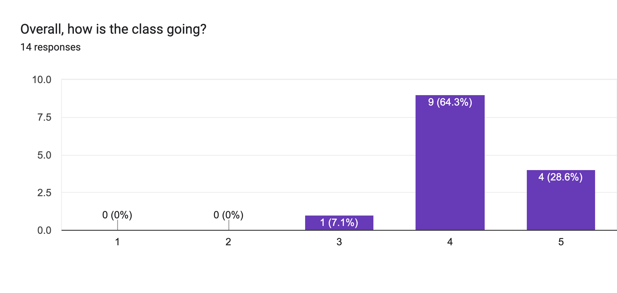
Course feedback

Slide 4
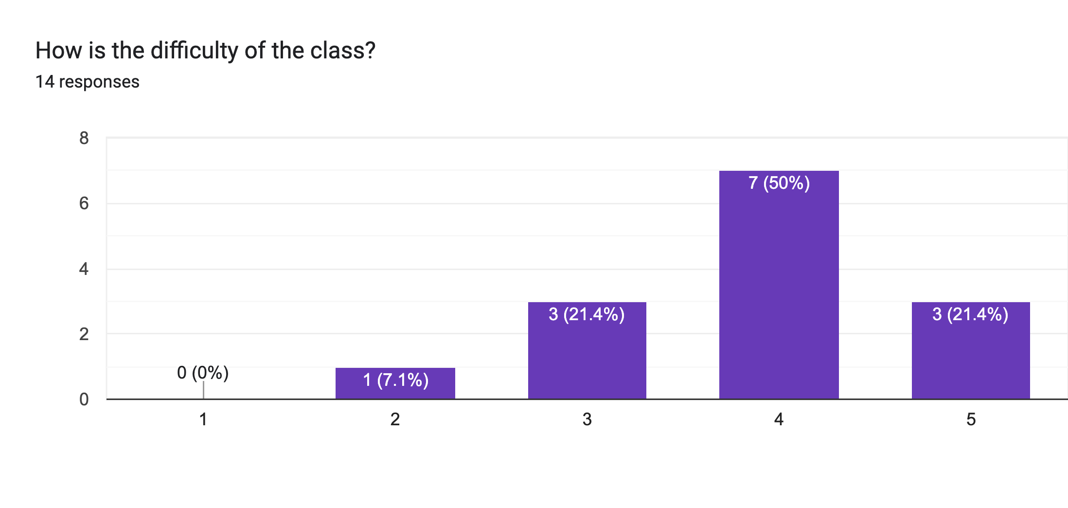
Course feedback

Slide 5
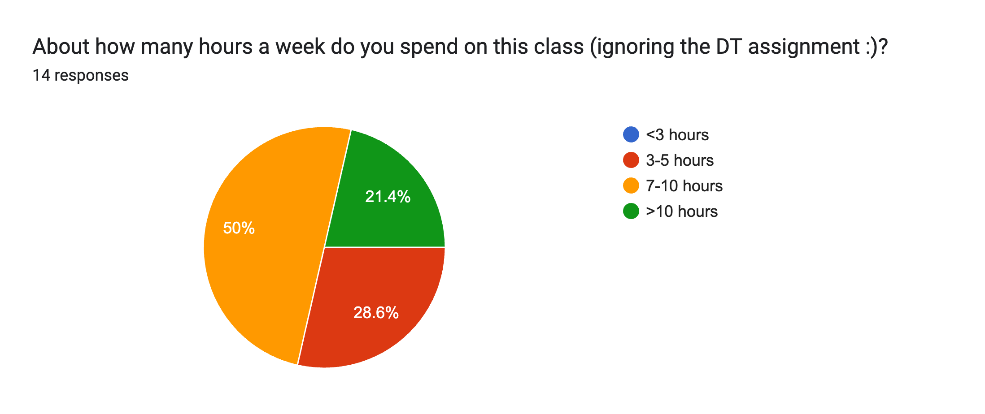
Course feedback

Slide 6
Favorite thing
I feel like my coding skills in general are improving significantly. I am practicing concise documentation/efficient coding.
I like the coding part of the class!
getting better at java

Slide 7
Improvements
Posting slides at the start of class.
I like to start the assignments as early as Monday night. I would love it if we had mentor sessions on Saturday as well. Or definitely both on Thursdays and Fridays the least, because Sunday is not enough if we are too far away from being done.
More mentor sessions :/ Not likely though. Maybe just three total would be awesome.
Releasing the assignments at the same time every week would help.

Slide 8
Improvements
Give the big picture - how everything we are leading connects? the life cycle of ML project maybe?
I wished we went deeper in the math side of things. I think implementing ML algorithms is fun and cool, so don't change that!

Slide 9
Improvements
Post the autograder score before we are done with the assignment. For several of these, we see our results, and they look good, but we don't know for sure if it's correct or not, so in a lot of cases we lose points on edge cases that we could've solved had we known they were problematic.

Slide 10
Other comments
We lost points on the first three assignments to JavaDocs for other stylistic reasons, but we hadn't gotten our scores for the first assignment until after we had turned in the third assignment, so we didn't know we were supposed to do the JavaDocs and got dinged three times for it.

Slide 11
MLE estimation for NB
train
probabilistic model
training data
What are the MLE estimates for these?

Slide 12
Maximum likelihood estimates
number of examples with label y
total number of examples
number of examples with label y with feature x_{i} = 1
number of examples with label
Notes:
just involves iterating over the data and aggregating these counts!

Slide 13
Maximum likelihood estimates
p(1) = ?
p(-1) = ?
x₁ | x₂ | label
1 | 1 | 1
1 | 0 | 1
1 | 1 | 1
0 | 1 | -1
0 | 0 | -1

Slide 14
Maximum likelihood estimates
p(1) = 3/5
p(-1) = 2/5
x₁ | x₂ | label
1 | 1 | 1
1 | 0 | 1
1 | 1 | 1
0 | 1 | -1
0 | 0 | -1

Slide 15
Maximum likelihood estimates
p(x₁ = 1 | 1) | ?
p(x₁ = 0 | 1) | ?
p(x₂ = 1| 1) | ?
p(x2 = 0| 1) | ?
x₁ | x₂ | label
1 | 1 | 1
1 | 0 | 1
1 | 1 | 1
0 | 1 | -1
0 | 0 | -1

Slide 16
Maximum likelihood estimates
p(x₁ = 1 | 1) | 3/3
p(x₁ = 0 | 1) | 0/3
p(x₂ = 1| 1) | 2/3
p(x2 = 0| 1) | 1/3
x₁ | x₂ | label
1 | 1 | 1
1 | 0 | 1
1 | 1 | 1
0 | 1 | -1
0 | 0 | -1

Slide 17

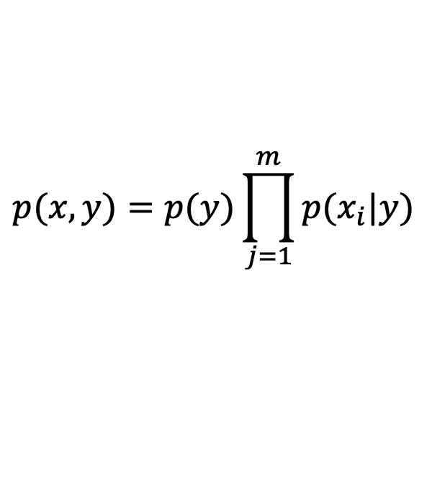
Maximum likelihood estimates
$$p(x,y)=p(y)\prod_{j=1}^{m}{p(x_{i}|y)}$$
p(x₁ = 1 | 1) | 3/3
p(x₁ = 0 | 1) | 0/3
p(x₂ = 1| 1) | 2/3
p(x2 = 0| 1) | 1/3
x₁ | x₂ | label
1 | 1 | 1
1 | 0 | 1
1 | 1 | 1
0 | 1 | -1
0 | 0 | -1
$$p(x_{1}=1,x_{2}=1,y=1)= ?$$

Slide 18
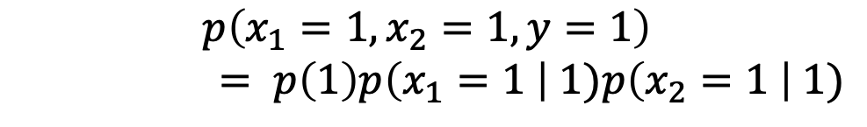
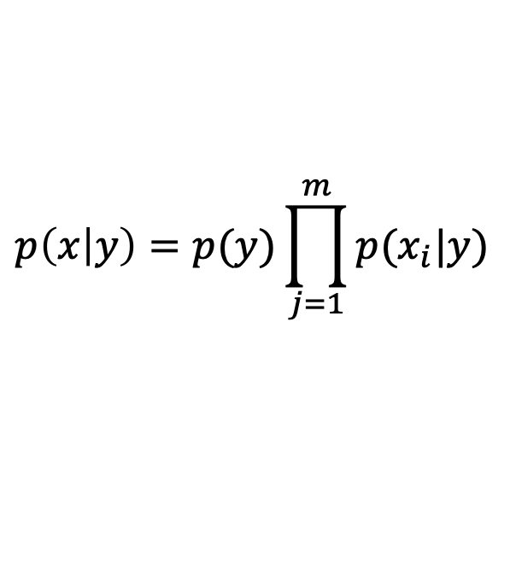
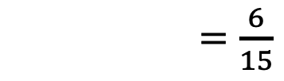
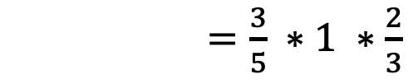
Maximum likelihood estimates
$$p\left(x | y\right)=p(y)\prod_{j=1}^{m}{p(x_{i}|y)}$$
p(x₁ = 1 | 1) | 3/3
p(x₁ = 0 | 1) | 0/3
p(x₂ = 1| 1) | 2/3
p(x2 = 0| 1) | 1/3
x₁ | x₂ | label
1 | 1 | 1
1 | 0 | 1
1 | 1 | 1
0 | 1 | -1
0 | 0 | -1
$$p\left(x_{1}=1,x_{2}=1,y=1\right)$$
$= p\left(1\right)p\left(x_{1}=1 \right| 1)p\left(x_{2}=1 \right| 1)$
$=\frac{3}{5} ∗1 ∗\frac{2}{3}$
$=\frac{6}{15}$

Slide 19

Maximum likelihood estimates
$$p(x,y)=p(y)\prod_{j=1}^{m}{p(x_{i}|y)}$$
p(x₁ = 1 | 1) | 3/3
p(x₁ = 0 | 1) | 0/3
p(x₂ = 1| 1) | 2/3
p(x2 = 0| 1) | 1/3
x₁ | x₂ | label
1 | 1 | 1
1 | 0 | 1
1 | 1 | 1
0 | 1 | -1
0 | 0 | -1
$$p(x_{1}=0,x_{2}=1,y=1)= ?$$

Slide 20
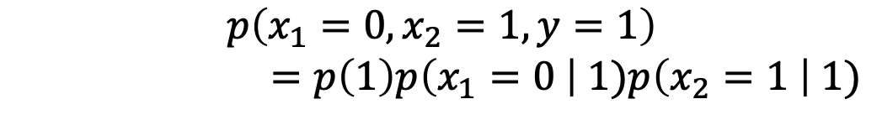

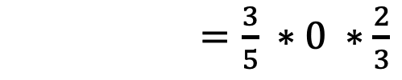
Maximum likelihood estimates
$$p(x,y)=p(y)\prod_{j=1}^{m}{p(x_{i}|y)}$$
p(x₁ = 1 | 1) | 3/3
p(x₁ = 0 | 1) | 0/3
p(x₂ = 1| 1) | 2/3
p(x2 = 0| 1) | 1/3
x₁ | x₂ | label
1 | 1 | 1
1 | 0 | 1
1 | 1 | 1
0 | 1 | -1
0 | 0 | -1
$$p\left(x_{1}=0,x_{2}=1,y=1\right)$$
$$=p\left(1\right)p\left(x_{1}=0 \right| 1)p\left(x_{2}=1 \right| 1)$$
$=\frac{3}{5} ∗0 ∗\frac{2}{3}$
$=0$
☹

Slide 21
Maximum likelihood estimates
p(1) = 3/5
p(-1) = 2/5
Full model trained!
p(x₁ = 1 | 1) | 3/3
p(x₂ = 1| 1) | 2/3
x₁ | x₂ | label
1 | 1 | 1
1 | 0 | 1
1 | 1 | 1
0 | 1 | -1
0 | 0 | -1
p(x₁ = 1 | -1) | 0/2
p(x₂ = 1| -1) | 1/2

Slide 22
Priors
Coin1 data: 3 Heads and 1 Tail
Coin2 data: 30 Heads and 10 tails
Coin3 data: 2 Tails
Coin4 data: 497 Heads and 503 tails
If someone asked you what the probability of heads was for each of these coins, what would you say?

Slide 23
Basic steps for probabilistic modeling
Probabilistic models
Step 1: pick a model
Step 2: figure out how to estimate the probabilities for the model
Step 3 (optional): deal with overfitting
Which model do we use, i.e. how do we calculate p(feature, label)?
How do train the model, i.e. how to we we estimate the probabilities for the model?
How do we deal with overfitting?

Slide 24
Training revisited
What we’re really doing during training is selecting the Θ that maximizes:
i.e.
That is, we pick the most likely model parameters given the data

Slide 25
Estimating revisited
We want to incorporate a prior belief of what the probabilities might be
To do this, we need to break down our probability
(Hint: Bayes rule)

Slide 26
Estimating revisited
What are each of these probabilities?

Slide 27
Priors
likelihood of the data under the model
probability of different parameters,
call the prior
probability of seeing the data (regardless of model)

Slide 28
Priors
Does p(data) matter for the argmax?
Notes:
no, it doesn’t very as theta changes. It’s a constant

Slide 29
Priors
likelihood of the data under the model
probability of different parameters,
call the prior
What does MLE assume for a prior on the model parameters?

Slide 30
Priors
likelihood of the data under the model
probability of different parameters,
call the prior
Assumes a uniform prior, i.e. all Θ are equally likely!
Relies solely on the likelihood

Slide 31
A better approach
We can use any distribution we’d like.
This allows us to impart addition bias into the model

Slide 32
Another view on the prior
Remember, the max is the same if we take the log:
We can use any distribution we’d like.
This allows us to impart addition bias into the model
Does this look like something we’ve seen before?

Slide 33
Regularization vs prior
likelihood based on the data
prior
fit
model bias
loss function based on the data
regularizer

Slide 34
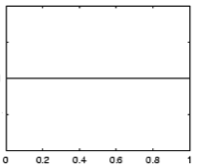
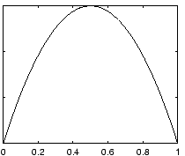
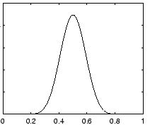
Prior for NB
Uniform prior
Dirichlet prior
λ= 0
increasing
Notes:
- as lambda gets larger we bias more and more towards

Slide 35
Prior: another view
MLE:
What happens to our likelihood if, for one of the labels, we never saw a particular feature?
Goes to 0!
Notes:
- Goes to 0!

Slide 36
Prior: another view
Adding a prior avoids this!

Slide 37
Smoothing
training data
for each label, pretend like we’ve seen each feature value occur in λ additional examples
Sometimes this is also called smoothing because it is seen as smoothing or interpolating between the MLE and some other distribution

Slide 38
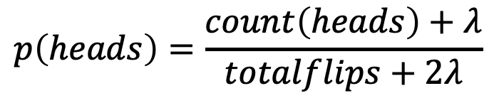
Priors
Coin1 data: 3 Heads and 1 Tail
Coin2 data: 30 Heads and 10 tails
Coin3 data: 2 Tails
Coin4 data: 497 Heads and 503 tails
$$p\left(heads\right)=\frac{count\left(heads\right)+λ}{totalflips+2λ}$$
Does this do the right thing in these cases?

Slide 39
Maximum likelihood estimates
ƛ = 1
x₁ | x₂ | label
1 | 1 | 1
1 | 0 | 1
1 | 1 | 1
0 | 1 | -1
0 | 0 | -1
p(x₁ = 1 | 1) | ?
p(x₁ = 0 | 1) | ?
p(x₂ = 1| 1) | ?
p(x2 = 0| 1) | ?

Slide 40
Maximum likelihood estimates
ƛ = 1
x₁ | x₂ | label
1 | 1 | 1
1 | 0 | 1
1 | 1 | 1
0 | 1 | -1
0 | 0 | -1
p(x₁ = 1 | 1) | 4/5
p(x₁ = 0 | 1) | 1/5
p(x₂ = 1| 1) | 3/5
p(x2 = 0| 1) | 2/5

Slide 41
Avoids zero probability events!
p(x₁ = 1 | 1) | 3/3
p(x₁ = 0 | 1) | 0/3
p(x₂ = 1| 1) | 2/3
p(x2 = 0| 1) | 1/3
p(x₁ = 1 | 1) | 4/5
p(x₁ = 0 | 1) | 1/5
p(x₂ = 1| 1) | 3/5
p(x2 = 0| 1) | 2/5
smoothed/prior

Slide 42
Basic steps for probabilistic modeling
Probabilistic models
Step 1: pick a model
Step 2: figure out how to estimate the probabilities for the model
Step 3 (optional): deal with overfitting
Which model do we use, i.e. how do we calculate p(feature, label)?
How do train the model, i.e. how to we we estimate the probabilities for the model?
How do we deal with overfitting?

Slide 43
Joint models vs conditional models
We’ve been trying to model the joint distribution (i.e. the data generating distribution):
However, if all we’re interested in is classification, why not directly model the conditional distribution:

Slide 44
A first try: linear
Any problems with this?
- Nothing constrains it to be a probability
- Could still have combination of features and weight that exceeds 1 or is below 0
Notes:
let’s try a different route this time
rather than deriving a model (the book does it that way)
let’s start with a type of model and see if we can work our way towards a working model

Slide 45
The challenge
Linear model
probability
+∞
1
We like linear models!
Can we transform the probability into a function that ranges over all values?
-∞
0

Slide 46
Odds ratio
Rather than predict the probability, we can predict the ratio of 1/0 (positive/negative)
Predict the odds that it is 1 (true): How much more likely is 1 than 0.
Does this help us?

Slide 47
Odds ratio
Linear model
odds ratio
+∞
+∞
Where is the dividing line between class 1 and class 0 being selected?
-∞
0

Slide 48
Odds ratio
We’re trying to find some transformation that transforms the odds ratio to a number that is -∞ to +∞
Does this suggest another transformation?
odds ratio
0 1 2 3 4 5 6 7 8 9 ….

Slide 49
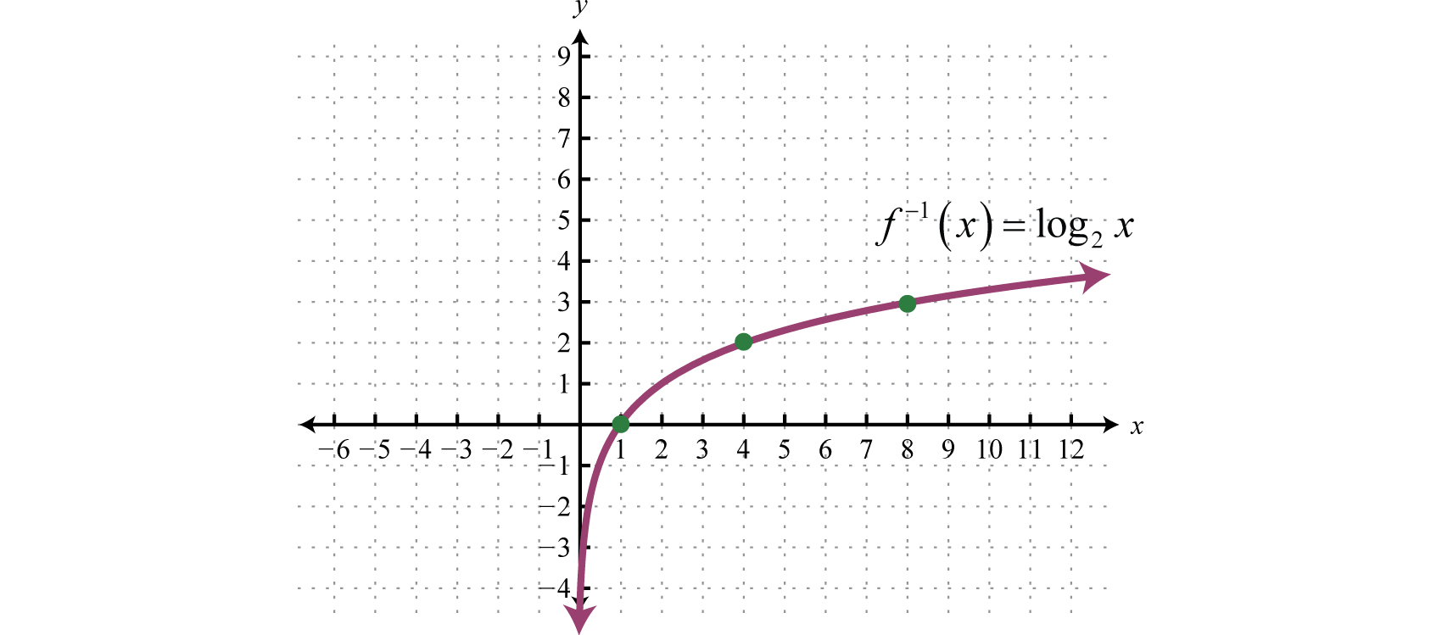
0 1 2 3 4 5 6 7 8 9 ….

Slide 50
Log odds (logit function)
=
Linear regression
odds ratio
+∞
+∞
How do we get the probability of an example?
-∞
-∞

Slide 51
Log odds (logit function)
…
anyone recognize this?

Slide 52
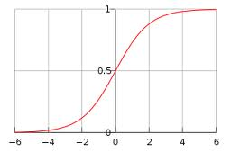
Logistic function

Slide 53
Logistic regression
How would we classify examples once we had a trained model?
If the sum > 0 then p(1)/p(0) > 1, so positive
if the sum < 0 then p(1)/p(0) < 1, so negative
Still a linear classifier (decision boundary is a line)

Slide 54
Training logistic regression models
How should we learn the parameters for logistic regression (i.e. the w’s and b)?
parameters

Slide 55
MLE logistic regression
Find the parameters that maximize the likelihood (or log-likelihood) of the data:
assume labels 1, -1

Slide 56
MLE logistic regression
We want to maximize, i.e.
Look familiar? Hint: anybody reading the book?

Slide 57
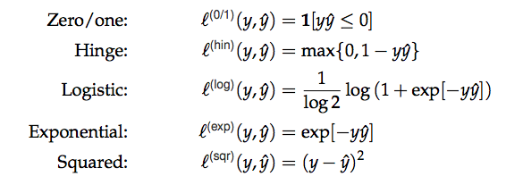
MLE logistic regression
Surrogate loss functions:

Slide 58
logistic regression: three views
linear classifier
conditional model
logistic
linear model minimizing logistic loss

Slide 59
Overfitting
If we minimize this loss function, in practice, the results aren’t great and we tend to overfit
Solution?

Slide 60
Regularization/prior
or
What are some of the regularizers we know?

Slide 61
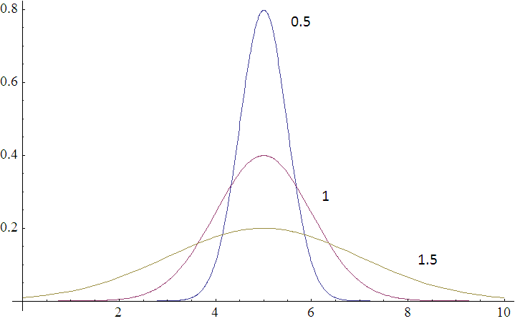
Regularization/prior
L2 regularization:
Gaussian prior:
Gaussians are defined by a mean (μ) and a variance (σ²)
p(w,b) ~

Slide 62
Regularization/prior
L2 regularization:
Gaussian prior:
Does the λ make sense?

Slide 63
Regularization/prior
L2 regularization:
Gaussian prior:
Notes:
Yes!
As the variance gets higher, the prior is weaker (more distributed probabilities). Higher variance = lower lambda.
As the variance gets lower, the prior is stronger (more peaked distribution). Lower variance = higher lambda.

Slide 64
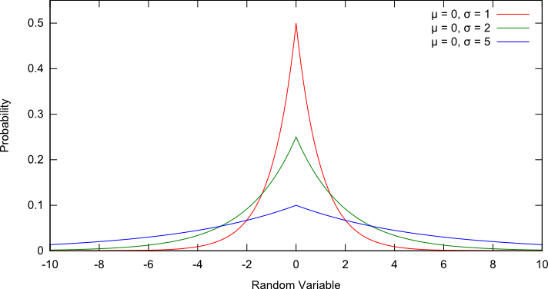
Regularization/prior
L1 regularization:
Laplacian prior:
p(w,b) ~

Slide 65
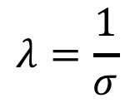
Regularization/prior
L1 regularization:
Laplacian prior:
$$λ=\frac{1}{σ}$$

Slide 66
L1 vs. L2
L1 = Laplacian prior
L2 = Gaussian prior

Slide 67
Logistic regression
Why is it called logistic regression?
It is a classifier??

Slide 68
A digression: regression vs. classification
Raw data
Label
features
Label
f₁, f₂, f₃, …, f_{n}
0
classification: discrete (some finite set of labels)
regression: real value
f₁, f₂, f₃, …, f_{n}
0
f₁, f₂, f₃, …, f_{n}
1
extract
features
f₁, f₂, f₃, …, f_{n}
1
f₁, f₂, f₃, …, f_{n}
0

Slide 69
linear regression
Given some points, find the line that best fits/explains the data
Our model is a line, i.e. we’re assuming a linear relationship between the feature and the label value
response (y)
f₁
How can we find this line?

Slide 70
Linear regression
Learn a line h that minimizes some loss/error function:
Sum of the individual errors:
response
(y)
0/1 loss!
feature (x)
Notes:
- squared error is optimal if we assume that the data was actually generated from a line with gaussian data

Slide 71
Error minimization
How do we find the minimum of an equation?
Take the derivative, set to 0 and solve (going to be a min or a max)
Any problems here?
Ideas?

Slide 72

Linear regression
response
squared error is convex!
feature
Notes:
- squared error is optimal if we assume that the data was actually generated from a line with gaussian data

Slide 73
Linear regression
Learn a line h that minimizes an error function:
response
in the case of a 2d line:
function for a line
feature
Notes:
- squared error is optimal if we assume that the data was actually generated from a line with gaussian data

Slide 74
Linear regression
We’d like to minimize the error
Find w₁ and w₀ such that the error is minimized
We can solve this in closed form

Slide 75
Multiple linear regression
If we have m features, then we have a line in m dimensions
weights

Slide 76
Multiple linear regression
We can still calculate the squared error like before
Still can solve this exactly!

Slide 77
Logistic function

Slide 78
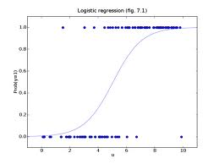
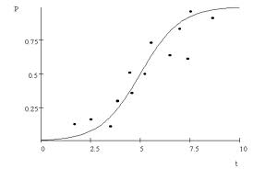
Logistic regression
Find the best fit of the data based on a logistic

Slide 79
Basic steps for probabilistic modeling
Probabilistic models
Step 1: pick a model
Step 2: figure out how to estimate the probabilities for the model
Step 3 (optional): deal with overfitting
Which model do we use, i.e. how do we calculate p(feature, label)?
How do train the model, i.e. how to we we estimate the probabilities for the model?
How do we deal with overfitting?

Slide 80
Probabilistic models summarized
Two classification models:
Naïve Bayes (models joint distribution)
Logistic Regression (models conditional distribution)
In practice this tends to work better if all you want to do is classify
Priors/smoothing/regularization
Important for both models
In theory: allow us to impart some prior knowledge
In practice: avoids overfitting and often tune on development data

